Slide 1
H1N1 FLU VACCINATION ANALYSIS
Va
By Lisa Mwangi

Slide 2
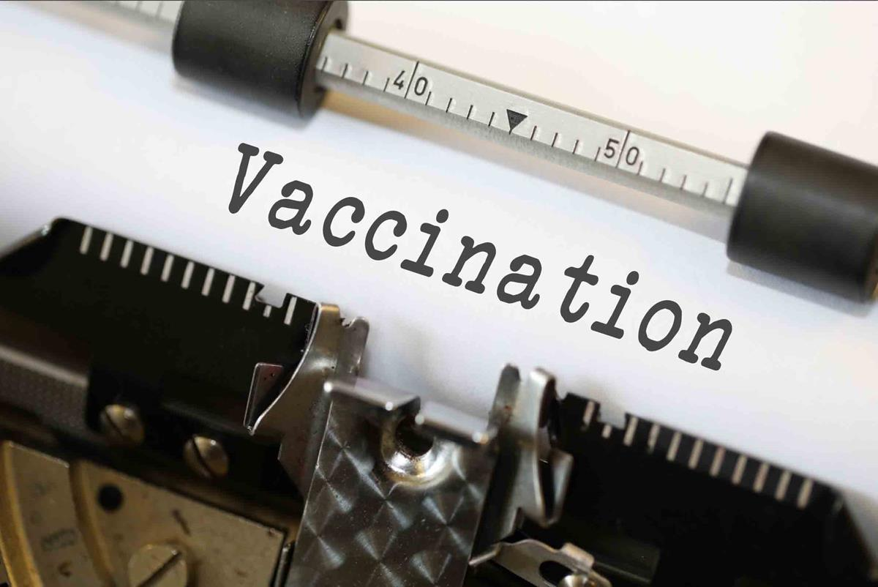
This Photo by Unknown Author is licensed under CC BY-SA

Slide 3
INTRODUCTION.
Vaccine is a biological substance introduced to an individual that stimulates the immune system to recognize and fight specific pathogens without causing the disease itself.
Vaccination is the administration of a vaccine to help the immune system develop immunity from a disease.
Vaccination is an effective tool that plays a crucial role in public health in preventing the spread of a disease. However there are several factors that impact vaccination rates such as Vaccination accessibility, Socioeconomic factors, beliefs or opinions and etc.
This study aims to analyze and how to deal with this factors and also we will be able to predict whether an individual got the H1N1 Flu vaccine.

Slide 4
BUSINESS PROBLEM.
Despite the availability of H1N1 vaccine many individuals are unvaccinated, identifying factors that influence vaccination uptake can help improve health intervention.

Slide 5
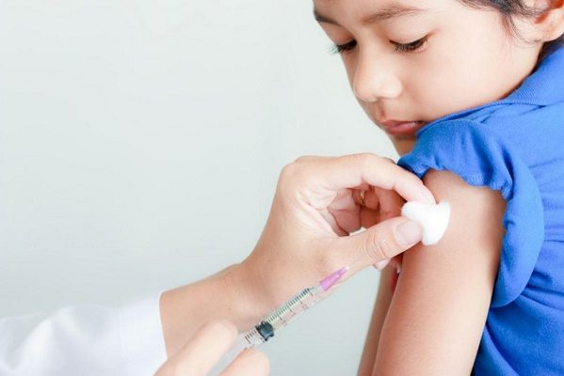
OBJECTIVES.
Main Objective: Develop a model to predict whether a person will get the H1N1 vaccine based on demographics, beliefs, and behaviors.
Specific Objectives are:
Understanding how Behavioral, Attitudinal and health factors impact Vaccination: Analyze factors like age, education, income, personal opinions affect vaccination uptake.
Evaluate the role of health recommendation in Vaccine decisions: Assess the impact of a healthcare practitioner in people’s decision for vaccination.
Identify discrepancies in vaccine access and acceptance: Analyze if there are forms of racial, geographic, and socioeconomic disparities in vaccination uptake.
This Photo by Unknown Author is licensed under CC BY

Slide 6
KEY BUSINESS QUESTIONS:
Who is more likely to get the H1N1 flu vaccine?
Are we reaching the protective vaccine coverage?
What influences individual vaccine decisions?
How do Healthcare practitioners influence vaccine uptake?
Which groups have the lowest vaccine uptake?

Slide 7
KEY FOCUS METRICS
In public health, particularly in vaccination campaigns, the top priority is to ensure that as many individuals as possible who need a vaccine are identified and vaccinated. Hence increase Recall. Recall measures the ability of a model to correctly identify individuals who got the vaccine.

Slide 8
DATA OVERVIEW.
The data was collected from The National H1N1 Flu survey. It contains various features such as age, education doctor recommendation and others
With this dataset various analysis has been done to be able to understand the impact of various factors to vaccination coverage, also a prediction model has been created in order to be able to predict whether an individual got the H1N1 vaccine.

Slide 9
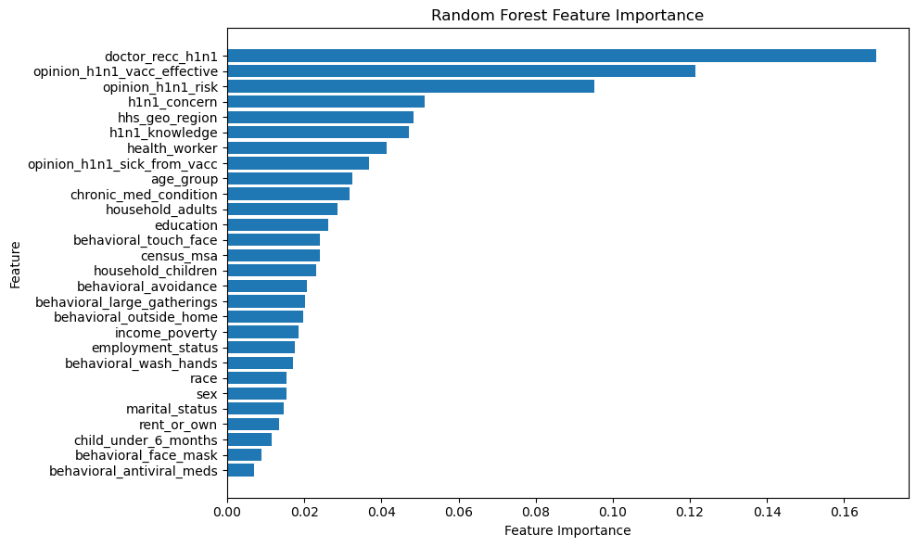
FEATURE IMPORTANCE.
The graph above illustrates the importance of every feature to the model creation process and it also illustrates how these features affected the vaccination coverage of H1N1 vaccine.

Slide 10
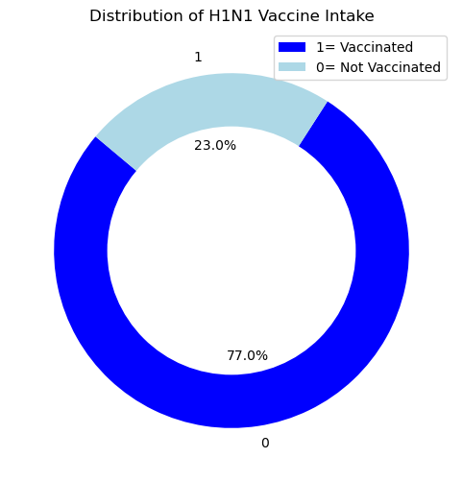
DISTRIBUTION OF H1N1 VACCINE INTAKE
The visualization above illustrates how majority of the individuals have not gotten a H1N1 Flu vaccination.

Slide 11
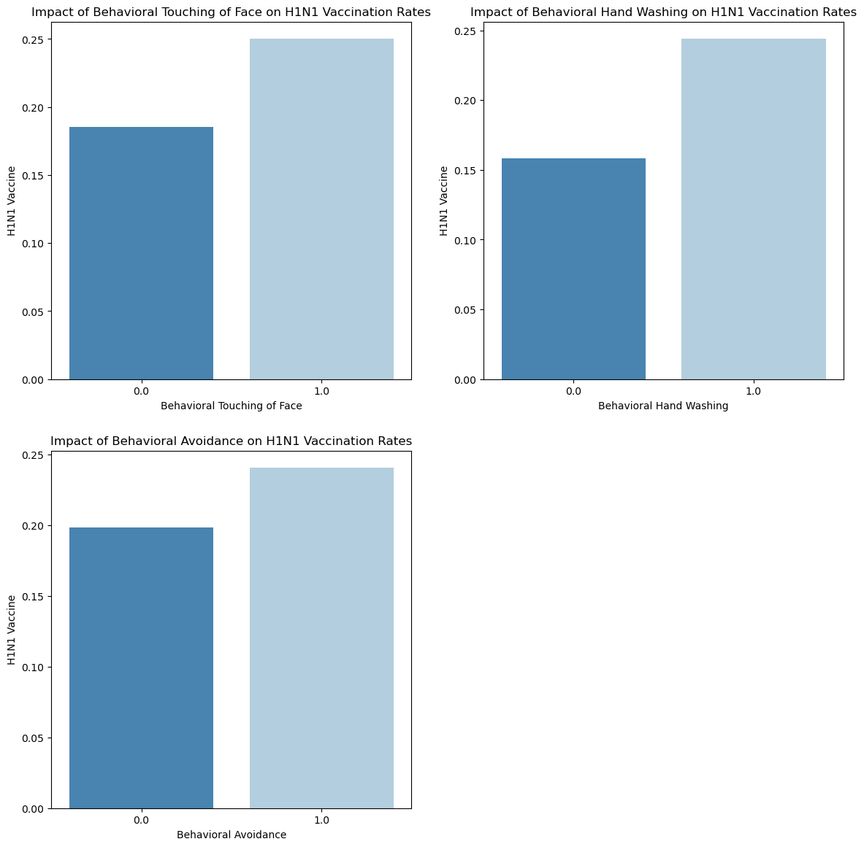
IMPACT OF BEHAVIORAL FACTORS ON VACCINATION RATES
Behavioral factors such as hygiene(washing of hands), exposure avoidance influence vaccination rates. In the graph above, it illustrates how this behaviors encourage people from getting vaccinated.
Such behavioral tendencies highly correlate to a more positive attitude towards vaccine.

Slide 12
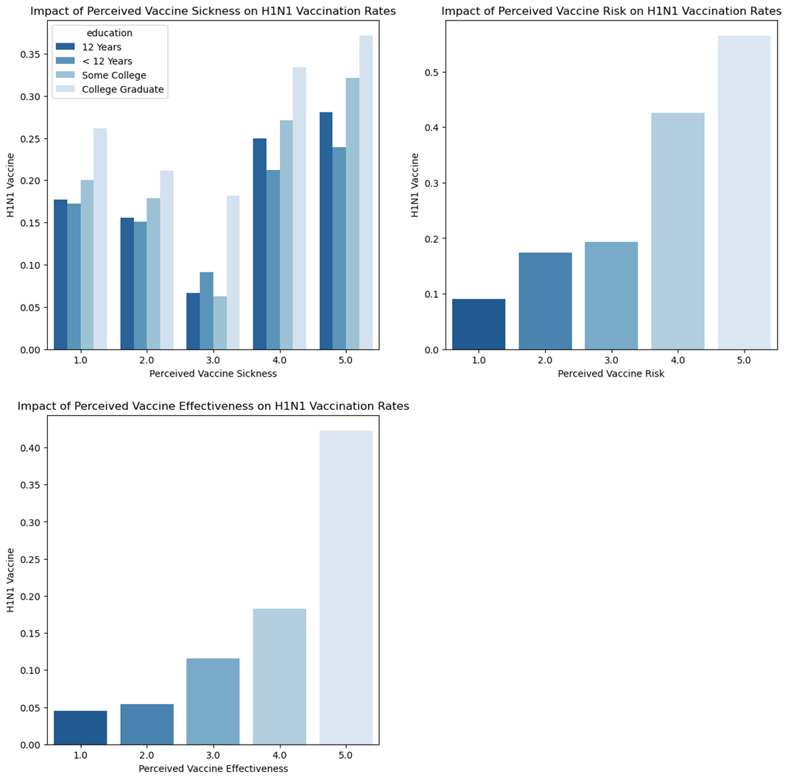
OPINION BASED DISTRI BUTION.

Slide 13
EXPLANATION:
.
The distribution above shows different opinions of individuals concerning the H1N1 vaccine in 3 different graphs:
1 = Very Low; 2 = Somewhat low; 3 = Don't know; 4 = Somewhat high; 5 = Very high
Graph 1: It illustrates that majority of the individuals especially college graduates are very worried that they will get sick after getting the H1N1 vaccine.
Graph 2: Illustrates how also majority of the people know the risk of not taking the vaccine.
Graph 3: Illustrates that majority of the individuals know that the H1N1 vaccine is effective.

Slide 14
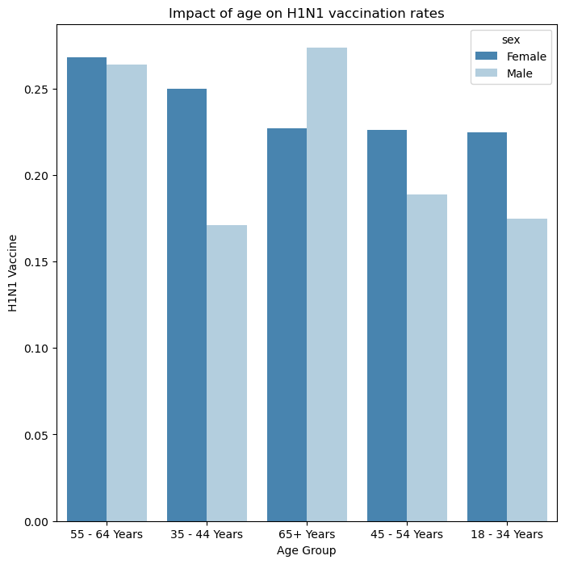
IMPACT OF AGE ON H1N1 VACCINATION RATES.
The graph above shows how the 55 – 64 yrs are the most vaccinated age group especially the females.

Slide 15
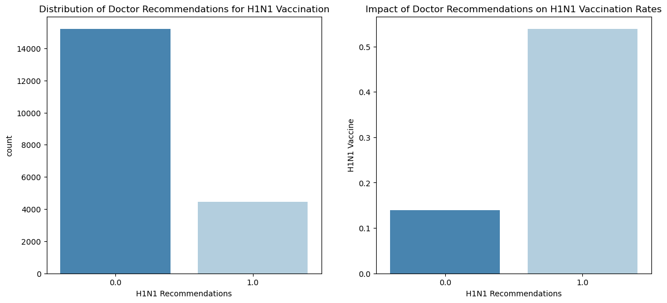
INFLUENCE OF DOCTORS ON VACCINATION RATES.
The graph above illustrates that minority of the individuals got recommendation from the doctor, that majority of the recommended individuals got vaccinated.

Slide 16
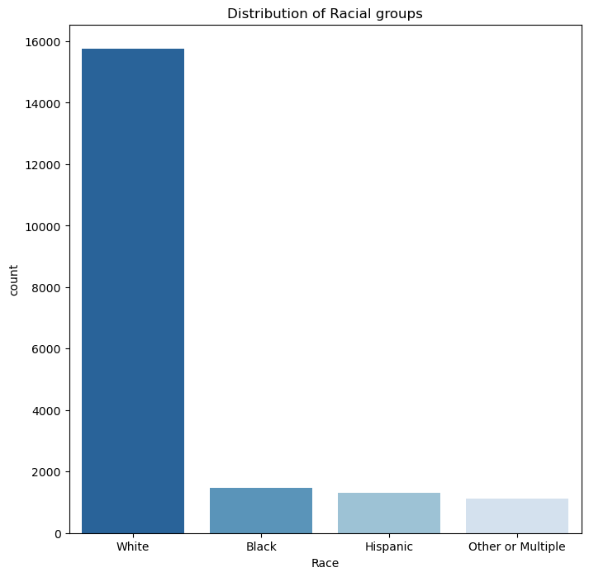
VACCINE UPTAKE BETWEEN RACIAL GROUPS.
The distribution above shows how majority of the vaccinated individuals are of white racial group.

Slide 17
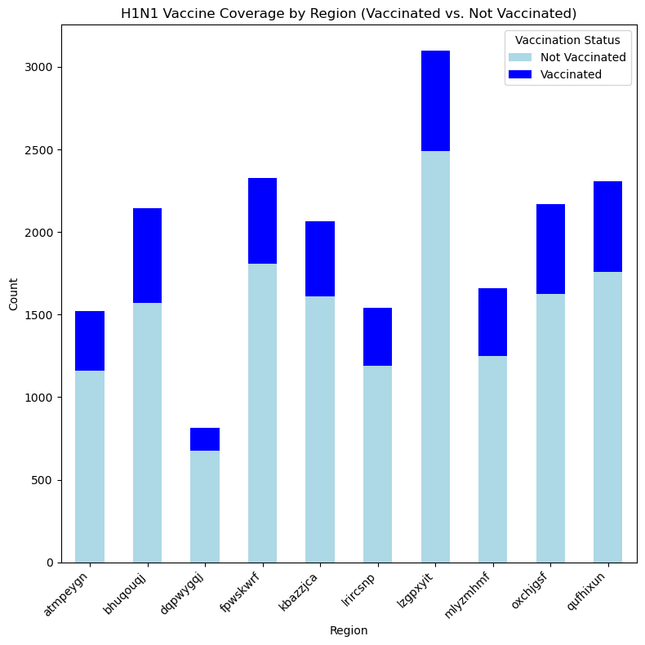
H1N1 VACCINE COVERAGE BY REGION.
The random characters visualized in the chart represents different regions this is done in order to maintain patient confidentiality.
The graph above illustrates the regions with the highest low vaccine coverage.

Slide 18
MODELING. MODEL SELECTION AND TRAINING.
Best Parameters for Random Forest using BayesSearch: OrderedDict([('max_depth', 18), ('max_features', 'sqrt'), ('min_samples_leaf', 1), ('min_samples_split', 3), ('n_estimators', 498)])
Random Forest Evaluation Metrics:
Training time: 578.3828537464142 and prediction time: 0.7153973579406738
Accuracy: 0.8895
Precision: 0.9147
Recall: 0.8626
ROC-AUC: 0.9521
BayesSearchCV had the best out put as compared to the other hyperparameters. I took into consideration recall metric since that is what my main focus was on.
Recall: This measures how many actual positives were predicted correctly.

Slide 19
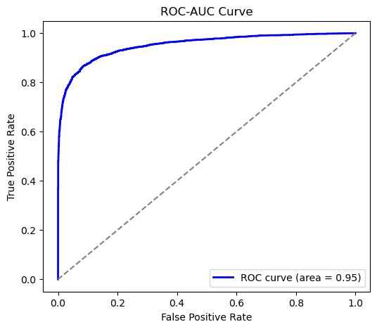
ROC-AUC CURVE.
The visual above represents the ROC-AUC curve
The ROC-AUC curve measures the ability of the model to correctly differentiate between classes. So the chart above explains that the model has a 95% probability of being able to distinguish between the 2 classes (class 0: Not vaccinated, Class 1: vaccinated)

Slide 20
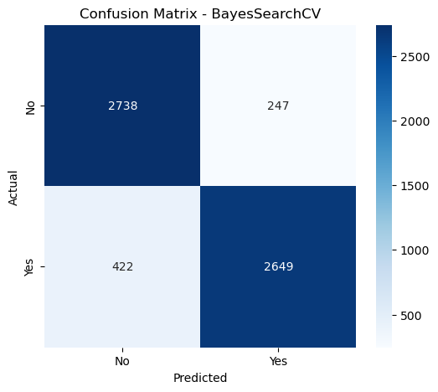
CONFUSION MATRIX.
A confusion Matrix is used to evaluate the performance of a model by comparing the actual and the predicted class labels.

Slide 21
EXPLANATION:
True Negatives (TN) = 2738: The model correctly predicted 2738 instances as negative (class 0).
-False Positives (FP) = 247: The model incorrectly predicted 247 instances as positive when they were actually negative.
-False Negatives (FN) = 422: The model incorrectly predicted 422 instances as negative when they were actually positive.
-True Positives (TP) = 2649: The model correctly predicted 2649 instances as positive (class 1).

Slide 22
CONCLUSION.
From the analysis drawn above sheds light that there many factors that affect H1N1 vaccination uptake and coverage.
Based on the data collected, objectives and the analysis the following conclusions were made:
Influence of Behavioral and Attitudinal Factors:
Behavioral risk factors, such as frequent hand-washing and avoiding large gatherings, are critical indicators that could be linked to an individual’s likelihood of receiving the H1N1 vaccine. Those who engage in these behaviors may have a higher level of health consciousness and may be more likely to accept preventive health measures, including vaccination.
Perceptions of vaccine efficacy and risk are strongly associated with vaccine decisions. Those who perceive the vaccine as more effective and view the risk of getting sick as higher are more likely to vaccinate. Conversely, those who worry about vaccine side effects, such as getting sick from the vaccine, tend to be less likely to receive it.
Role of Healthcare Practitioners:
Healthcare recommendations have a significant impact on vaccine uptake. The data suggests that individuals who received a recommendation from their doctor (either for the H1N1 or seasonal flu vaccine) were more likely to get vaccinated. This underlines the importance of healthcare providers in influencing vaccination behavior.
Socioeconomic and Demographic Factors:
Socioeconomic factors, such as income and education level, have a considerable effect on vaccination uptake. Higher levels of education and income appear to be correlated with higher vaccination rates, indicating that individuals with greater access to healthcare information and resources may be more likely to vaccinate.
Age, race, and geographic location also play a role in vaccine decisions. Disparities in vaccine uptake are particularly noticeable across different racial, socioeconomic, and geographic groups, which suggests that certain communities are underserved in terms of vaccine access and acceptance.
Discrepancies in Vaccine Access and Acceptance:
There is evidence of disparities in vaccine uptake, with certain groups (such as lower-income households and specific racial groups) showing lower rates of vaccination. These discrepancies highlight the need for targeted interventions that address access issues and vaccine hesitancy in these communities.
Herd Immunity and Vaccine Coverage:
The data indicates that protective vaccine coverage levels may not have been reached for H1N1, which is critical for achieving herd immunity. The likelihood of reaching sufficient vaccine coverage is influenced by both individual vaccine decisions and broader population-level factors, such as herd immunity thresholds and distribution effectiveness.

Slide 23
BUSINESS RECOMMENDATION.
Targeted Health Campaigns Based on Behavioral Insights:
Public health campaigns should target individuals who are less likely to engage in preventive behaviors (e.g., not washing hands frequently, attending large gatherings, or touching their face). Emphasizing the importance of the H1N1 vaccine alongside these preventive behaviors could encourage a more holistic approach to health protection.
Additionally, addressing concerns about side effects and emphasizing the vaccine’s effectiveness could reduce hesitancy. Educational materials should be tailored to address common misconceptions about vaccine safety.
Enhance Healthcare Provider Engagement:
Given the strong influence healthcare practitioners have on vaccine decisions, improving doctor-patient communication around vaccines should be prioritized. Health practitioners should actively recommend vaccines during consultations, particularly for high-risk groups, and be trained to address vaccine hesitancy and concerns directly.
Address Socioeconomic and Demographic Disparities:
Targeted outreach is needed to ensure that underserved communities have access to vaccines and accurate information. Programs aimed at lower-income households, rural populations, and specific racial or ethnic groups should be implemented to reduce barriers to vaccination.
Mobile vaccination clinics or partnerships with community organizations can help increase access to vaccines in underserved geographic regions.
Promote Vaccine Knowledge and Trust:
Vaccine literacy programs should be implemented to increase individuals’ understanding of the benefits and safety of vaccination. This could include addressing common fears about vaccine side effects and providing data on the long-term benefits of vaccination in preventing disease spread.
Using trusted community leaders to endorse vaccination within specific communities may help overcome resistance, especially in groups with higher vaccine hesitancy.
Increase Focus on Behavioral Risk Factors:
Encourage individuals who engage in risk-reducing behaviors (e.g., wearing masks, hand washing) to view vaccination as part of their broader health strategy. Health campaigns can frame vaccination as a complementary strategy to hygiene and social distancing, particularly during flu seasons.
Improving Vaccine Accessibility:
Policies should be implemented to ensure equitable vaccine distribution, particularly in areas where access is limited. This includes extending vaccine availability through pharmacies, clinics, and workplace settings, as well as subsidizing costs for those without insurance or those in lower-income households.
Research on Long-Term Vaccine Uptake:
More research is needed to understand the long-term trends in vaccine uptake, especially in light of future pandemic responses. Understanding how past experiences (e.g., H1N1) shape attitudes toward future vaccines can guide policy-making and improve public health preparedness.

Slide 24



Slide 25


